Slide 1
1st background paper

Slide 2
1st background paper
Method
  Formalin test and micro-injections
    Five minutes after infusion of 0.5 ml of either 0.25% bupivacaine or saline, animals were injected with 50 ml of 1% formalin subcutaneously into the plantar surface of the hind-paw contralateral to the drug or saline administration.
    The amount of time the injected paw was elevated was recorded in 5-min intervals during the 70-min period following formalin injection.

Slide 3
1st background paper
Method
  Open-field test and micro-injections
    The open field test was used to determine whether micro-injection of bupivacaine into the NuAc affected the animals’ motor behavior - (i.e. their ability to elevate their paw following the formalin injection).
    Animals were placed in an open field which consisted of an open area.
    Motor activity was measured as the number of lines crossed and the amount of time the animal spent moving.

Slide 4
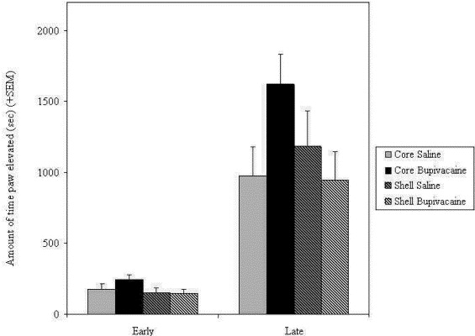
Fig. 3. Mean time paw elevated during the early and late phases of the formalin test.
Jane E. Magnusson, Roxanne V. Martin
Additional evidence for the involvement of the basal ganglia in formalin-induced nociception: the role of the nucleus accumbens
Brain Research, Volume 942, Issues 1–2, 2002, 128–132
http://dx.doi.org/10.1016/S0006-8993(02)02489-7

Slide 5
Summary
The present results implicate the involvement of the NuAc core, but not the NuAc shell, as playing a direct role in the modulation of persistent nociception.
Additionally, by way of the dopaminergic pathways between the areas of the NuAc and other areas of the brain, these results provide additional evidence for the involvement of dopamine in nociception.

Slide 6
2nd background paper

Slide 7
2nd background paper
Method
  Pain and mood parameters
    The short form of the McGill pain questionnaire (MPQ)
      12 sensory and 4 affective descriptors
    Positive Affect Negative Affect Score (PANAS)
      includes 60 items
      measures positive and negative affect
    Beck’s Depression Inventory
  Scanning parameters (fMRI)
    MPRAGE type T1-anatomical brain images
    3T Siemens Trio whole-body scanner

Slide 8
2nd background paper
Method
  Voxel based morphometry (VBM)
    Longitudinal changes in gray matter density
    VBM using FSL 4.1.4. First, a left-right–symmetric study-specific gray matter template
    images were smoothed with isotropic Gaussian kernel
  Functional connectivity analysis
    Functional correlation maps were produced using a well-validated method

Slide 9
2nd background paper
Method
  ROI analysis
    Differences in gray matter density changes across group and visits were performed
    Anatomical ROIs (aROI) were defined from the VBM longitudinal analysis
    Determined by averaging the gray matter density for all voxels in the given ROI
    Using a repeated-measure ANCOVA with gender and age as confounds

Slide 10
2nd background paper

Slide 11
2nd background paper

Slide 12
2nd background paper

Slide 13
Summary
The corticolimbic mPFC-NAc connection is an accurate predictor of the transition from subacute to chronic pain
That motivation-valuation circuitry predicts pain persistence raises the possibility that, as with positive reinforcement learning, the NAc contributes to an aversive teaching signal that leads to sustained pain intensity over time following a static peripheral injury.

Slide 14
Main Paper

Slide 15
Main Paper
Method
  Virus construction and packaging
    Recombinant adeno-associated virus (AAV) vectors were serotyped with AAV1 coat proteins and packaged by the viral vector core
  Drugs
    3-dihydroxy-6-nitro-7-sulfamoyl benzo[f]quinoxaline-2,3-dione (NBQX), an AMPA receptor antagonist

Slide 16
Main Paper
Method
  Stereotaxic cannula implantation and intracranial viral injections
    Rats were anesthetized with isoflurane (1.5–2%)
    Virus was delivered to the prelimbic region of the prefrontal cortex (PL-PFC) only
  SNI surgery
    The common peroneal and tibial nerves were tied with nonabsorbent 5-0 silk sutures at the point of trifurcation
    The nerves were then cut distal to each knot, and 5 mm of the distal ends were removed
    In sham surgeries (control), above nerves were dissected but not cut

Slide 17
Main Paper
Method
  Immunohistochemistry
  In vivo electrophysiology
  Whole-cell recordings
    Somatic whole-cell recordings were made from pyramidal cells in the prelimbic cortex and medium spiny neurons in the NAc

Slide 18
Main Paper
Method
  Animal behavioral tests
    Animals received either AAV1.hSyn.ChR2-eYFP.WPRE.hGH / AAV1.hSyn.eYFP.WPRE.hGH (control group) in the PL-PFC
    Optical stimulation in the PFC were done 2 weeks after viral injection
    Tests with stimulation in the NAc core were done 6–8 weeks after injection

Slide 19
Main Paper
Method
  Mechanical allodynia test
    Traditional Dixon up-down method with von Frey filaments was used to measure mechanical hypersensitivity
  Cold allodynia test
    A drop of acetone was applied to the lateral plantar surface of the paws
    Scoring system was applied: 0, no visible response or startle response lasting 0.5 s; 1, paw withdrawal lasting 5 s; 2, withdrawal lasting 5–10 s, with or without licking of the paws; 3, prolonged repetitive withdrawal lasting 10 s

Slide 20
Main Paper
Method
  Hargreaves test (Plantar test)
    To evaluate thermal hyperalgesia, used a radiant heat-emitting device
    The latency to paw withdrawal was recorded automatically
    Repeated five times at 5 min intervals on each paw, the averages of the five measurements were taken
  CPP (Conditioned place preference)
    Standard three compartment apparatus (Stoelting) consisting of two large compartments of equal size (45 x 40 x 35 cm) joined by a tunnel (40 x 9 x35 cm)

Slide 21
Main Paper
Method
  SPT (Sucrose preference test)
    Animals were trained for 2–7 d to drink from two bottles (1% sucrose solution vs water)
  FST (Forced swim test)
  Locomotor activities
    Using video analysis software (ANY-maze), animal movements were tracked during a 30 min test

Slide 22
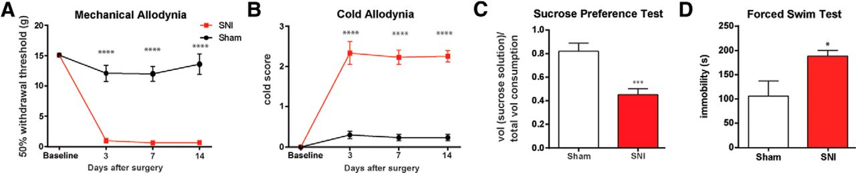

SNI evokes sensory and depressive symptoms of chronic pain.
Michelle Lee et al. J. Neurosci. 2015;35:5247-5259
©2015 by Society for Neuroscience
Notes:
SNI evokes sensory and depressive symptoms of chronic pain. A, B, SNI-treated rats developed mechanical and cold allodynia, compared with sham-treated rats. Two-way ANOVA with repeated measures and Bonferroni's post-test, n = 6, p < 0.0001. C, SNI-treated rats developed decreased preference for sucrose in the SPT, a test of anhedonia. Student's t test, n = 8, p < 0.001. D, SNI-treated rats developed decreased motivation or behavioral despair, as indicated by prolonged immobility on the FST. Student's t test, n = 4, p < 0.05. Error bars show mean and SEM.

Slide 23
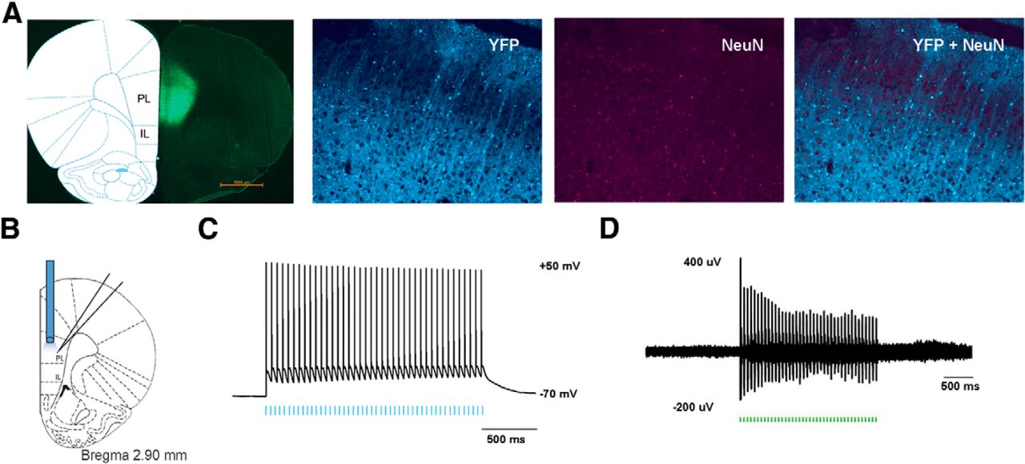
Functional expression of ChR2 in PL-PFC neurons.
Michelle Lee et al. J. Neurosci. 2015;35:5247-5259
©2015 by Society for Neuroscience
Notes:
Functional expression of ChR2 in PL-PFC neurons. A, Histologic expression of ChR2-eYFP in the PL-PFC 14 d after viral injection. ChR2-eYFP was found to be restricted to neurons in the PL-PFC region. NeuN, Neuronal marker. B, Schematic showing electrophysiological recordings were conducted at the site of light delivery. Data were collected from prefrontal neurons 14 d after viral injections in the PL-PFC. C, Whole-cell patch-clamp recording showed that direct illumination with an LED in brain slices containing the PL-PFC elicited spikes with high fidelity in prefrontal neurons. LED pulses are represented below in blue. D, In vivo recording at the virus injection site with simultaneous photoactivation demonstrated that laser pulses reliably triggered spikes in PL-PFC neurons. Laser pulses are represented below in green.

Slide 24
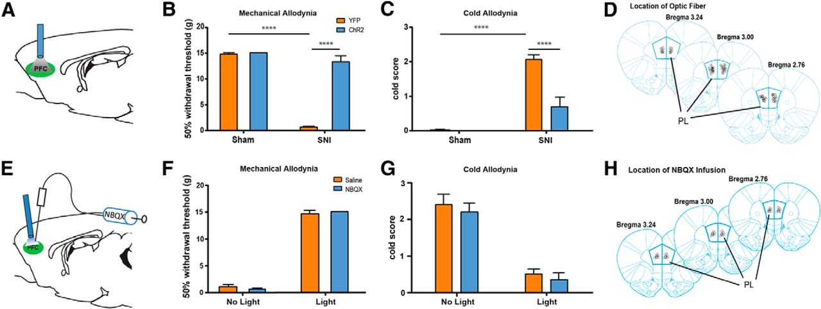
Activation of PL-PFC neurons relieves sensory allodynia in a rat chronic neuropathic pain (SNI) model.
Michelle Lee et al. J. Neurosci. 2015;35:5247-5259
©2015 by Society for Neuroscience
Notes:
Activation of PL-PFC neurons relieves sensory allodynia in a rat chronic neuropathic pain (SNI) model. A, Optical fibers were positioned directly above viral injection sites in the PL-PFC. Photoactivation occurred during behavior tests. B, Illumination of ChR2-expressing neurons in the PL-PFC decreased mechanical allodynia in SNI-treated rats, but not in sham-treated rats. Light treatment did not have any effect on animals that received vectors containing eYFP only. Two-way ANOVA with Bonferroni's post-test, n = 8–9, p < 0.0001. Light treatment was performed ≥2 weeks after SNI/sham procedures. C, Illumination of ChR2-expressing neurons in the PL-PFC decreased cold allodynia in SNI-treated rats. Two-way ANOVA with Bonferroni's post-test, n = 8–9, p < 0.0001. Light treatment was performed ≥2 weeks after SNI/sham procedures. D, Schematic showing the locations of optic fibers. E, To test the contribution of local circuits within the PL-PFC to the antiallodynic effects of prefrontal activation, NBQX was injected into the PL-PFC before photoactivation and behavior assays. Tests were performed on SNI-treated rats that expressed ChR2. F, Compared with saline, NBQX infusion in the PFC did not alter mechanical allodynia in SNI-treated rats, with or without light activation of the PFC. Student's t test, n = 5 (light), n = 6–7 (no light), p > 0.05. G, NBQX infusion in the PFC did not alter cold allodynia in SNI-treated rats, with or without light activation of the PFC. Student's t test, n = 5 (light), n = 6–7 (no light), p > 0.05. H, Schematic showing the locations of NBQX infusion in the PL-PFC. Error bars show mean and SEM.

Slide 25
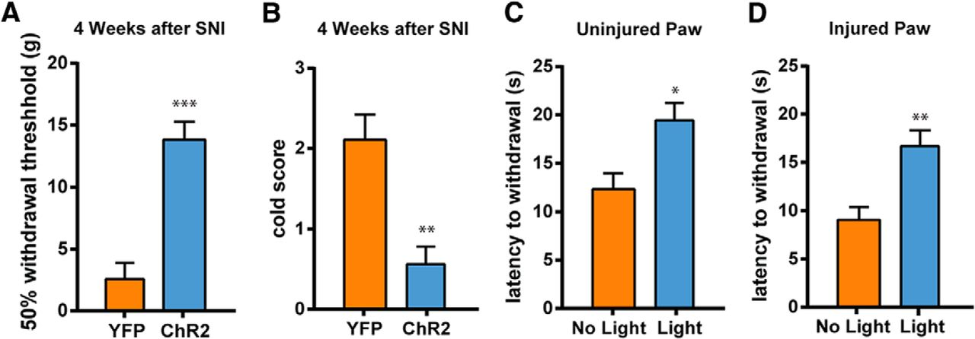
Activation of PL-PFC neurons elevates acute nociceptive threshold and relieves chronic neuropathic pain.
Michelle Lee et al. J. Neurosci. 2015;35:5247-5259
©2015 by Society for Neuroscience
Notes:
Activation of PL-PFC neurons elevates acute nociceptive threshold and relieves chronic neuropathic pain. A, Photoactivation of the PL-PFC relieved mechanical allodynia of the injured paws 4 weeks after SNI. Student's t test, n = 5, p < 0.001. B, Activation of the PL-PFC relieved cold allodynia of the injured paws 4 weeks after SNI. Student's t test, n = 4, p < 0.01. C, Activation of the PL-PFC increased the latency to withdrawal of the uninjured (contralateral) paws of SNI-treated rats on the Hargreaves test. Student's t test, n = 5, p < 0.05. D, Activation of the PL-PFC increased the latency to withdrawal of the injured paws of SNI-treated rats. Student's t test, n = 5, p < 0.01. Error bars show mean and SEM.

Slide 26
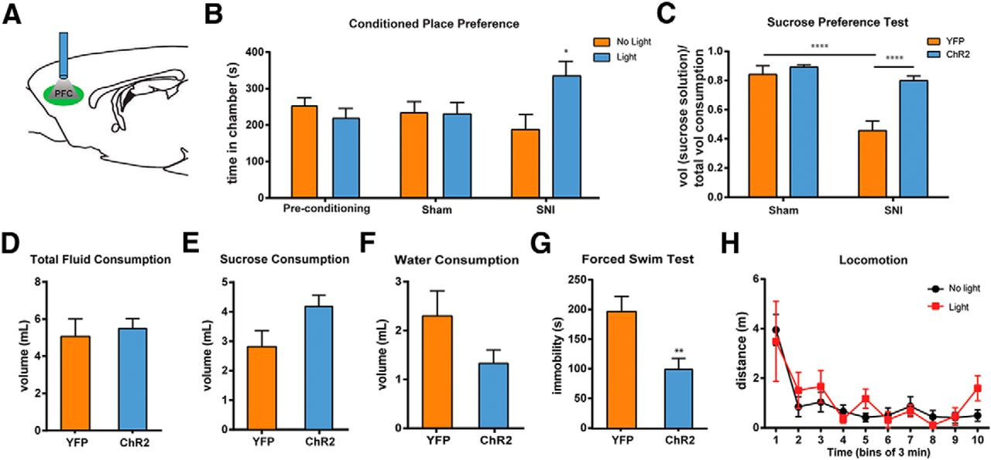
Prefrontal activation relieves the aversive quality and depressive symptoms associated with chronic pain.
Michelle Lee et al. J. Neurosci. 2015;35:5247-5259
©2015 by Society for Neuroscience
Notes:
Prefrontal activation relieves the aversive quality and depressive symptoms associated with chronic pain. A, Schematic of the light treatment. B, Light activation in the PL-PFC induced chamber preference in SNI-treated, but not sham-treated, rats. Two-way ANOVA with repeated measures and Bonferroni's post-test was used to compare preconditioning with test values, n = 7, p < 0.05 for the SNI group, n = 5, p > 0.05 for the sham group. C, Photoactivation of the PL-PFC improved sucrose preference in animals with chronic pain. Two-way ANOVA with Bonferroni's post-test, n = 8–10, p < 0.0001. D, Photoactivation of the PL-PFC had no effect on total fluid consumption during the SPT in SNI-treated rats. Student's t test, p > 0.05. E, Activation of the PL-PFC caused a trend of increase in sucrose consumption during the SPT in SNI-treated rats. Student's t test, p > 0.05. F, Activation of the PL-PFC caused a trend of decrease in water consumption during the SPT in SNI-treated rats. Student's t test, p > 0.05. G, Photoactivation of the PL-PFC decreased immobility on the FST in SNI-treated rats. Student's t test, n = 5–9, p < 0.01. H, Locomotor activity was not altered by PL-PFC photoactivation. Two-way ANOVA with repeated measures, n = 4–8, p > 0.05. Error bars show mean and SEM.

Slide 27
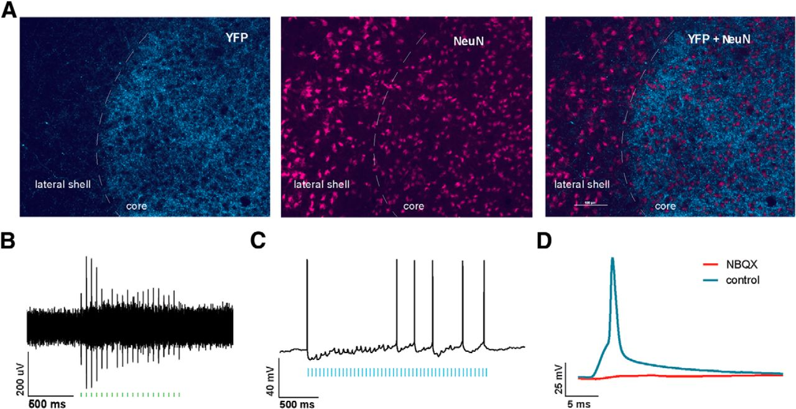
Light treatment in the NAc core selectively activates axon terminals of prefrontal neurons that project to the NAc core.
Michelle Lee et al. J. Neurosci. 2015;35:5247-5259
©2015 by Society for Neuroscience
Notes:
Light treatment in the NAc core selectively activates axon terminals of prefrontal neurons that project to the NAc core. A, ChR2-eYFP expression was found in the axon terminals of PL-PFC neurons in the NAc core 4 weeks after viral injections in the PL-PFC. B, In vivo recordings from the NAc core showed that light treatment in the NAc produced spikes. C, Whole-cell patch-clamp recordings from slices containing the NAc core showed that LED pulses produce EPSPs and spikes in MSNs of the NAc core. D, Light-induced EPSPs in the NAc were blocked by bath application of NBQX.

Slide 28
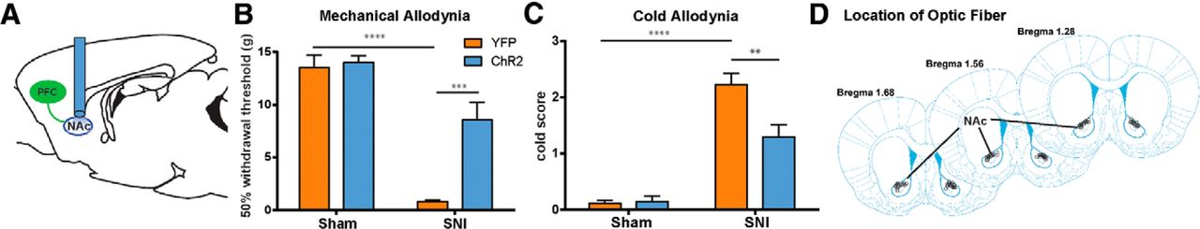
Activation of prefrontal projections to the NAc core has antinociceptive effects in the chronic neuropathic pain state.
Michelle Lee et al. J. Neurosci. 2015;35:5247-5259
©2015 by Society for Neuroscience
Notes:
Activation of prefrontal projections to the NAc core has antinociceptive effects in the chronic neuropathic pain state. A, Schematic showing the experimental paradigm. Four weeks after viral injections in the PL-PFC, light treatment was performed in the NAc core to activate prefrontal neurons that project to the NAc during behavior tests. B, Photoactivation of PL-PFC axons in the NAc core reduced mechanical allodynia in SNI-treated rats expressing ChR2-eYFP. Two-way ANOVA, n = 4–7, p < 0.001. C, Activation of PL-PFC axons in the NAc core reduced cold allodynia in SNI-treated rats expressing ChR2-eYFP. Two-way ANOVA, n = 4–8, p < 0.01. D, Schematic showing the locations of optic fibers in the NAc core. Error bars show mean and SEM.

Slide 29
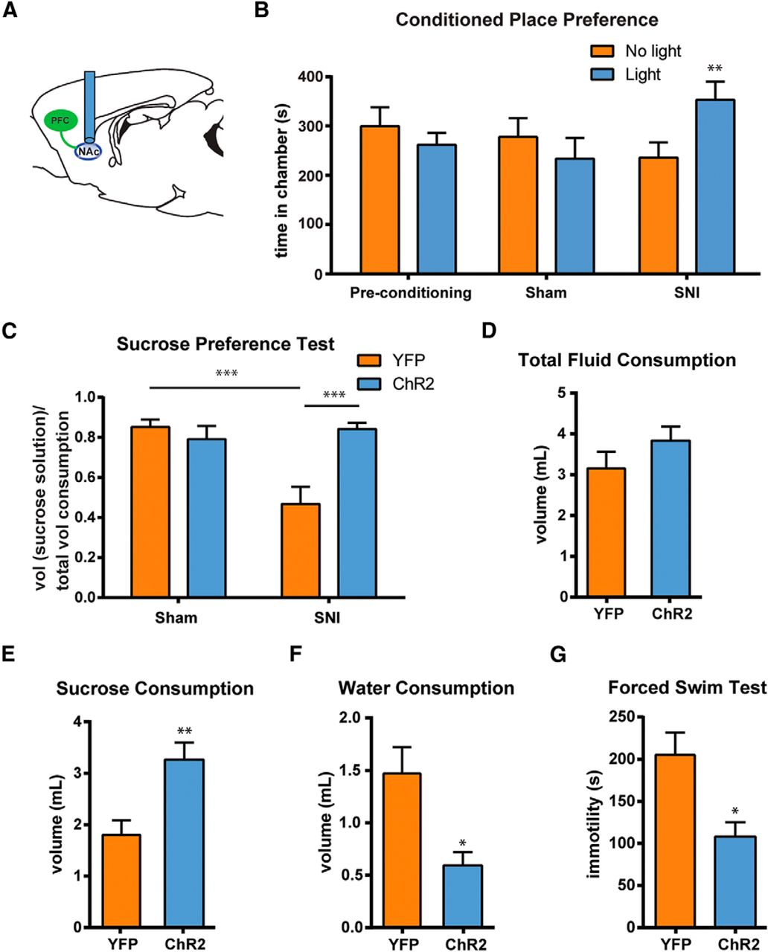
Activation of prefrontal projections to the NAc core relieves the affective symptoms associated with chronic pain.
Michelle Lee et al. J. Neurosci. 2015;35:5247-5259
©2015 by Society for Neuroscience
Notes:
Activation of prefrontal projections to the NAc core relieves the affective symptoms associated with chronic pain. A, Schematic of the light treatment. B, Light activation of the corticostriatal circuit induced chamber preference in SNI-treated, but not sham-treated, rats. Two-way ANOVA with repeated measures and Bonferroni's post-test, n = 8, p < 0.01 for the SNI group; n = 7, p > 0.05 for the sham group. C, Photoactivation of the prefrontal projection to the NAc core improved sucrose preference in SNI-treated rats. Two-way ANOVA, n = 6–7, p < 0.001. D, Photoactivation of the PL–NAc circuit had no effect on the total fluid consumption of SNI-treated rats during the SPT. Student's t test, p > 0.05. E, Activation of the PL–NAc circuit increased sucrose consumption in SNI-treated rats during the SPT. Student's t test, p < 0.01. F, Activation of the PL–NAc circuit decreased water consumption in SNI-treated rats during the SPT. Student's t test, p < 0.05. G, Activation of the prefrontal projection to the NAc core decreased immobility on the FST in SNI-treated rats. Student's t test, n = 5–6, p < 0.05. Error bars show mean and SEM.

Slide 30
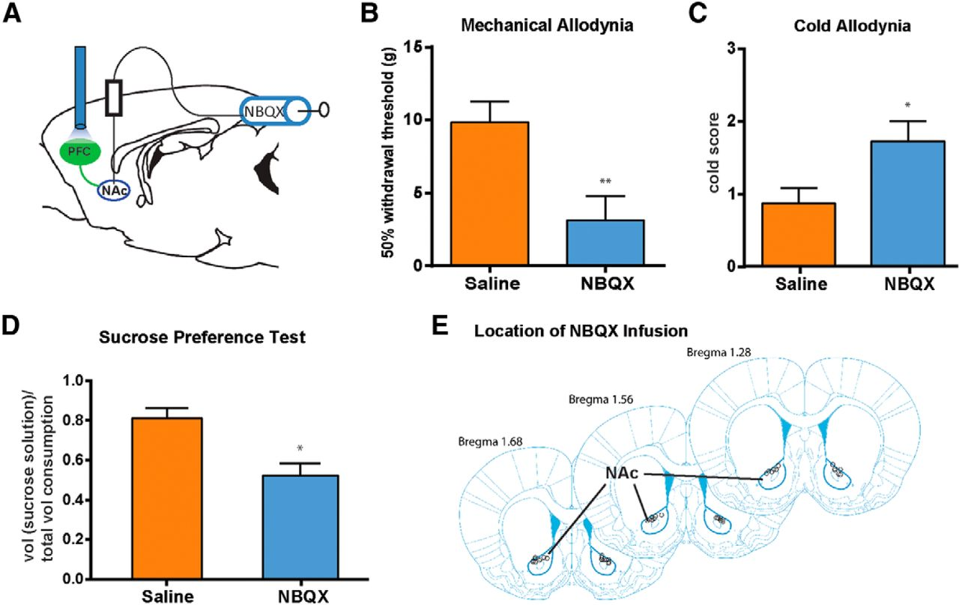
NBQX in the NAc blocks the pain-relieving effects of photoactivation of the PL-PFC.
Michelle Lee et al. J. Neurosci. 2015;35:5247-5259
©2015 by Society for Neuroscience
Notes:
NBQX in the NAc blocks the pain-relieving effects of photoactivation of the PL-PFC. A, To test the role of the corticostriatal circuit in pain regulation, NBQX was injected into the NAc core before photoactivation of the PL-PFC and behavior tests. Tests were performed on SNI-treated rats that expressed ChR2. B, NBQX infusion in the NAc blocked the effect of PFC activation on mechanical allodynia in SNI-treated rats. Student's t test, n = 9–11, p < 0.01. C, NBQX infusion in the NAc blocked the effect of PL-PFC activation on cold allodynia in SNI-treated rats. Student's t test, n = 8–10, p < 0.05. D, NBQX infusion in the NAc blocked the effect of light treatment in the PL-PFC on sucrose preference in SNI-treated rats. Student's t test, n = 4–5, p < 0.05. E, Schematic showing the locations of NBQX infusion in the NAc core. Error bars show mean and SEM.

Slide 31
Summary
Optogenetic activation of the PFC produces strong antinociceptive effects in a rat model (spared nerve injury model) of persistent neuropathic pain
PFC activation also reduces the affective symptoms of pain. This pain-relieving function of the PFC is likely mediated by projections to the Nac, supporting a novel role for corticostriatal circuitry in pain regulation

